Slide 1
‘GAMING’

Slide 3
Movies have ratings to inform you who they are appropriate for.
If you are under the age of the rating, the movie will contain content
that is not appropriate for you to watch!

Slide 4
Did you know Games also have ratings? These are called PEGI ratings.

Slide 5
Games have ratings to inform you who they are appropriate for.
If you are under the age of the rating, the game will contain content
that is not appropriate for you to watch!

Slide 6
Fortnite is rated 12
This is due to it’s
level of violence.

Slide 7
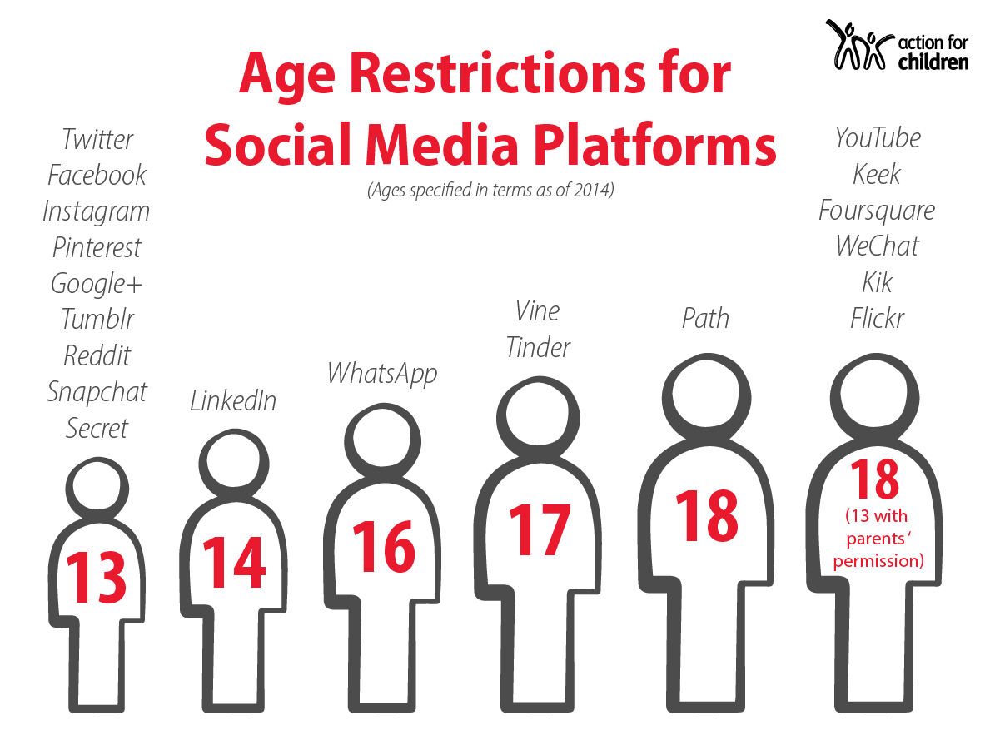

Slide 8
Take responsibility for what you play…
When you hear about a game or find one you want to play it, you should check it’s PEGI rating and content warnings to see if it is suitable for you to play.
Speak to your parents or teacher about it and discuss whether you should be playing it or not.
Don’t play a game just because you hear everyone else is playing it.
There are plenty of games out there with a 3 or 7 PEGI rating…

Slide 10
If you’re not talking to your real friends...
Who are you talking to?

Slide 11
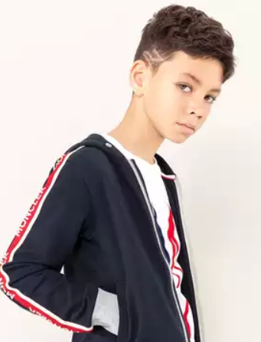
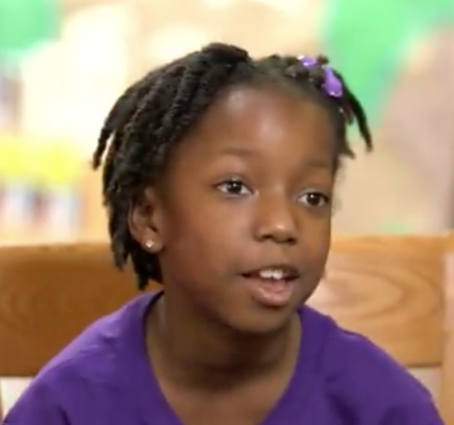
Can you match the player to their profile picture?
1
2
3
A
B
c

Slide 12
DO NOT HAVE FRIENDS ONLINE WHO YOU DO NOT KNOW IN REAL LIFE!
They are strangers!
They could be lying about who they are e.g. fake age, fake name.
They could use inappropriate language and phrases with you.
They can find sneaky ways to get personal information out of you without you realising it.
e.g. Your user name is funny, do you have a nickname your friends call you? I like your accent, where were you born? Do you still live around there?
If you have online friends who you don’t know – DELETE THEM when you get home! It is for your own safety.

Slide 13
What would you do?
Your cousin is obsessed with an online game and is playing well into the night without his parents’ permission. It is beginning to affect his school work and concentration.
You are in a chatroom and start up a conversation with someone who says they are 10. They ask you to send a picture so that they can see what you look like.
You have taken a silly video of your bestie. You like the video and want to post it onto social media and end it to your cousin.

Slide 14
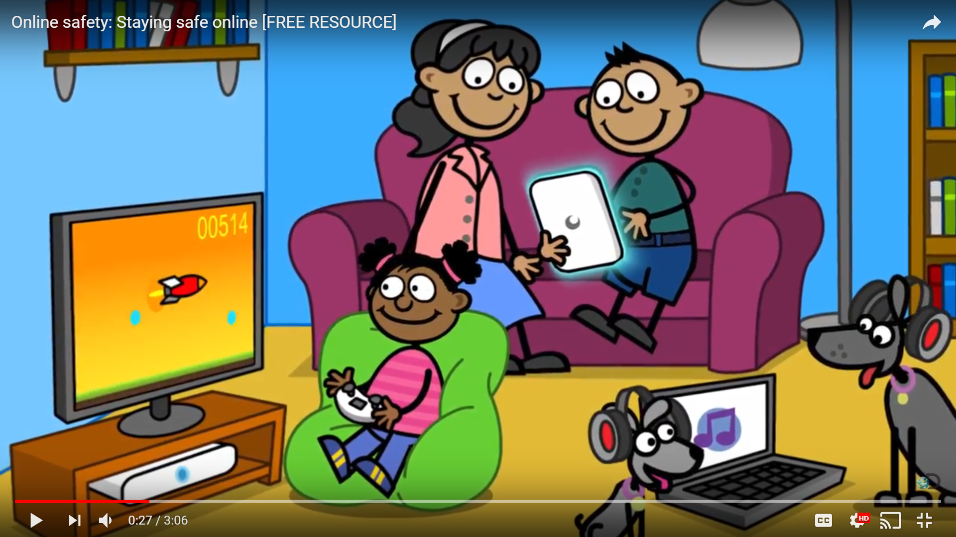
https://www.youtube.com/watch?v=aMSHtE42mmI

Slide 15
You are
invited!
You are
invited!

